Slide 1

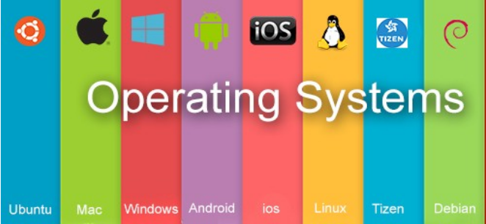
Operating System BCSC0004
Dr.Ajitesh Kumar
Associate Professor
GLAU

Slide 2
Module-I
Introduction: Operating System and its Classification - Batch, Interactive, Multiprogramming, Time sharing, Real Time System, Multiprocessor Systems, Multithreaded Systems, System Protection, System Calls, Reentrant Kernels, Operating System Structure- Layered structure, Monolithic and Microkernel Systems, Operating System Components, Operating System Functions and Services.
Processes: Process Concept, Process States, Process State Transition Diagram, Process Control Block (PCB), Process Scheduling Concepts, Threads and their management.
CPU Scheduling: Scheduling Concepts, Performance Criteria, Scheduling Algorithms, Multiprocessor Scheduling.
Process Synchronization: Principle of Concurrency, Implementation of concurrency through fork/join and parbegin/parend, Inter Process Communication models and Schemes, Producer / Consumer Problem, Critical Section Problem, Dekker’s solution, Peterson’s solution, Semaphores, Synchronization Hardware.
Classical Problem in Concurrency: Dining Philosopher Problem, Readers Writers Problem.

Slide 3
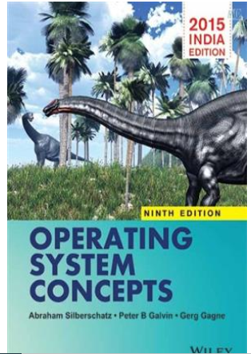
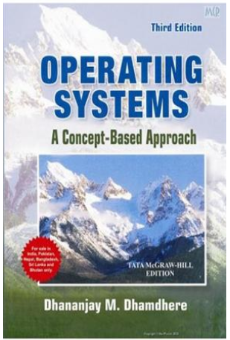
Reference Books
Text Books:
Silberschatz, Galvin and Gagne (2012), “Operating Systems Concepts”,9th Edition, Wiley.
D M Dhamdhere (2006), “Operating Systems: A Concept Based Approach”, 3rd Edition
Reference Books
Harvey M Dietel (2002), “An Introduction to Operating System”, 2nd Edition, Pearson
Education.

Slide 4
Operating System Introduction & Functions
OS makes a BARE machine usable.

Slide 5
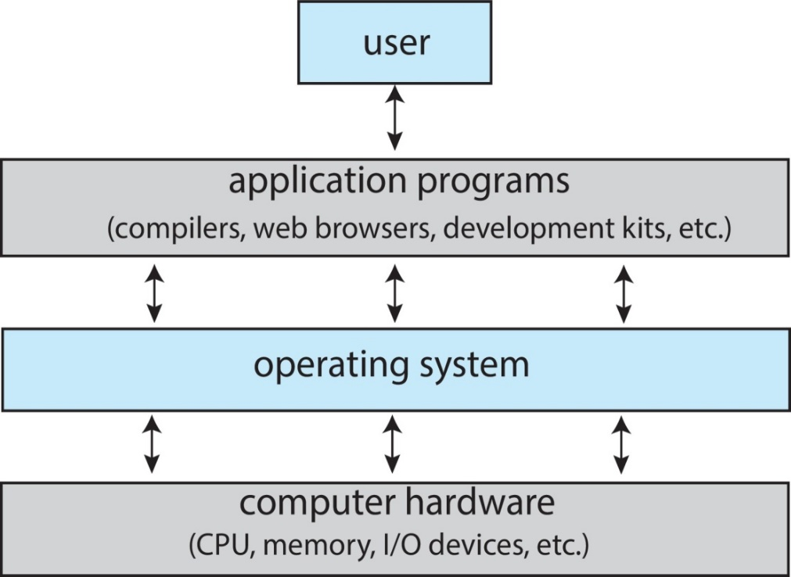
It is a system software
OS is an interface between user and hardware.
Resource Allocator
Manager:
Memory
Process
Files
Security etc
Goal:
Primary Goal: 1. Convenience of use (For small PCs)
2. Throughput
Secondary Goal: Efficient utilization of Resources i.e h/w and s/w (for large, shared and multiuser systems).
Example: Windows(Microsoft)
macOS (Macintosh), used for Apple’s personal computers and workstations (MacBook, iMac).
iOS (Apple’s OS for iPhone, iPad, and iPod Touch)
Android (Google’s Operating System for smartphones/tablets/smartwatches)
Linux/Ubuntu(open source)
An operating system acts as an intermediary between the user of a computer and computer hardware. The purpose of an operating system is to provide an environment in which a user can execute programs conveniently and efficiently.

Slide 6
What is operating system?
a) collection of programs that manages hardware resources
b) system service provider to the application programs
c) link to interface the hardware and application programs
d) all of the mentioned
• Operating system is a collection of
a) Software routine
b) Input-output device
c) Hardware components
d) All of these
Which one is correct hierarchy of memory according to speed and cost?
a) Magnetic tape, magnetic disk, cache, main memory, registers
b) Magnetic disk, magnetic tape, cache, main memory, registers
c) Magnetic tape, magnetic disk, registers, cache, main memory
d) Magnetic tape, magnetic disk, main memory, cache, registers
Which one of the following is not a secondary storage?
a) magnetic disks
b) magnetic tapes
c)CD ROM
d) RAM

Slide 7
Function of OS
Memory Management
Keeps tracks of primary memory, i.e., what part of it are in use by whom, what part are not in use.
In multiprogramming, the OS decides which process will get memory when and how much.
Allocates the memory when a process requests it to do so.
De-allocates the memory when a process no longer needs it or has been terminated.
Allocate and free memory

Slide 8
Processor Management
Keeps tracks of processor and status of process. The program responsible for this task is known as traffic controller.
Allocates the processor (CPU) to a process.
De-allocates processor when a process is no longer required.
End , abort, Load, Execute, Create process, terminate process,

Slide 9
Resource Management
Keeps tracks of all devices. Program responsible for this task is known as the I/O controller.
Decides which process gets the device when and for how much time.
Allocates the device in the efficient way.
De-allocates devices.
Request device , release device, Read , write , Get device attributes, Set device attributes

Slide 10
Storage/File Management
Keeps track of information, location, uses, status etc. The collective facilities are often known as file system.
Decides who gets the resources.
Allocates the resources.
De-allocates the resources.
Create file, Delete file, Open , close, Read, write, Get file attributes, Set file attributes

Slide 11
Security & Privacy

Slide 12
Types of OS
Batch OS
Multiprogramming
Multitasking
Multiprocessing
Distributed
Real-Time
Networked

Slide 13
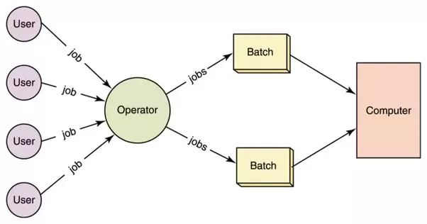
Batch Operating System
In batch operating system same type of processes are batched together for execution.
Eg: Bank Statements, Payroll System
Problem with Batch OS
1. Starvation
2. Not Interactive

Slide 14
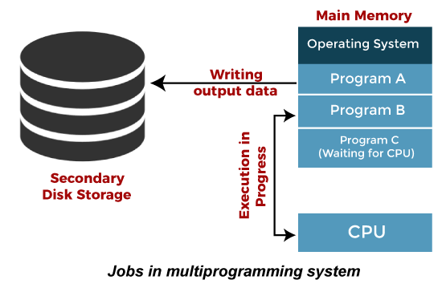
Multiprogramming Operating System
It is an extension to batch processing where the CPU is always kept busy.
Each process needs two types of system time: CPU time and IO time.
When a process does its I/O, The CPU can start the execution of other processes
Pipeline Execution
Non-preemptive
Improves the efficiency of the system.
Improves CPU Utilization
Multiprogramming increases CPU utilization by
organizing jobs so that the CPU always has something
to execute.

Slide 15
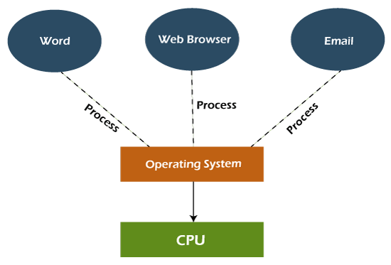
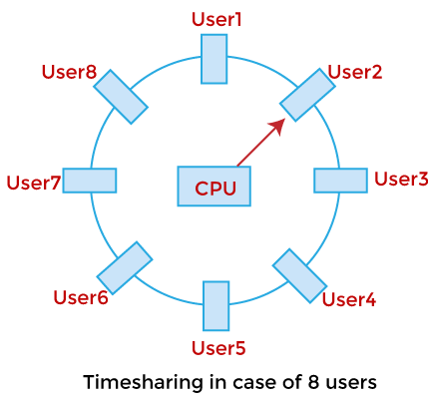
Multitasking/Time-Sharing Operating System
It is a logical extension of a multiprogramming system
Enables execution of multiple programs simultaneously.
Switching between the program
Preemptive
It allows a user to perform more than one
computer task at the same time.
Reduced Response time.

Slide 16
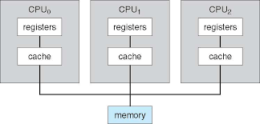
Multiprocessing Operating System
More than one processors present in the system.
Parallel computing is achieved.
Increased throughout
Increased reliability
Complex and sophisticated as it
takes care of multiple CPUs simultaneously.

Slide 17
1. Symmetric Multiprocessing :
Each processor runs an identical copy of the OS and copies communicate with one another as needed.
Each processor performs all tasks within OS.
All Processor are Peer and no Master Slave relationship exists.
In Symmetric Multiprocessing treats all processors as equals and no I/O can be processed on any CPU.
2. Asymmetric Multiprocessing :
Each processor is assigned a specific task.
A master processor controls the system. The other processors look to the master for instructions or predefined task. Thus, this defines master-slave relationship.
Master Processor schedules and allocates the work to the slave processor.
Each processor has its own address space.

Slide 18
Distributed Operating System
Distribute computation among several processors.
The processor does not share memory or a clock. Instead each processor has its own local memory
The Processor communicates with one another through various communications line such as high speed buses and telephone lines.
These systems are usually referred as Loosely Coupled Systems.
The processors may vary in size and functionality. These processors are referred as sites, nodes and computers.
Advantages :
Resources Sharing:
Computational Speed-up
Reliability
Communication

Slide 19
Real Time Operating System
Each job carries a certain deadline within which the job is supposed to be completed.
If the result is produced after the specified time limit or deadline, it will be completely useless.
Real-Time system exists in the case of military applications, if you want to drop a missile, then the missile is supposed to be dropped with a certain precision.
Real-time operating systems are very costly to develop.
Real-time operating systems are very complex and can consume critical CPU cycles.

Slide 20
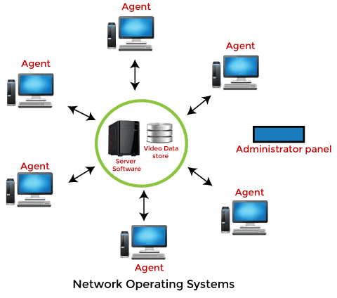
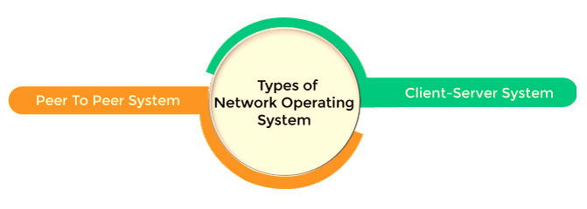
Network Operating System
It includes software and associated protocols to communicate with other computers via a network conveniently and cost-effectively.
Network traffic reduces due to the division
between clients and the server.

Slide 21
CPU Utilization − CPU remains busy as much possible. It should make efficient use of CPU.
Throughput − Throughput is the amount of work completed in a unit of time.
Response time − Response time is the time taken to start responding to the request.
Turnaround time − Turnaround time refers to the time between the moment of submission of a job/ process and the time of its completion, means how long it takes to execute.
Preemptive - The ability of the operating system to preempt (that is, stop or pause) a currently scheduled task.
Non Preemptive – Operating system Can’t stop and pause a currently scheduled task or job or process, unless it stop or pause by itself to perform input-output operation or to access any other resource.

Slide 22
Throughput of a system is
a) Number of programs processed by it per unit time
b) Number of times the program is invoked by the system
c) Number of requests made to a program by the system
d) None of the above
Logical extension of multiprogramming of operating system is
a) Time sharing
b) Distributed computing
c) Single programming
d)Batch processing
Which operating system implementation has to focus on the issue of Good response time
a) Batch Processing
b) Multiprogramming
c) Distributed
d) Time sharing
Which operating system implementation has to focus on the issue of resource sharing?
a) Batch Processing
b) Multiprogramming
c) Distributed
d) Time sharing

Slide 23
Operating-System Structures
Simple
2. Layered

Slide 24
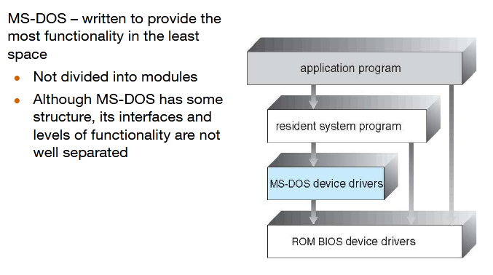
Simple Structure -- MS-DOS

Slide 25
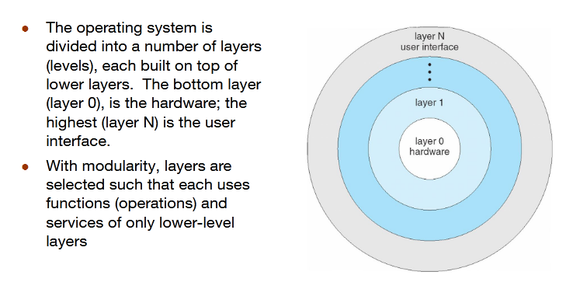
Layered Approach

